Slide 1
CS 3186
Nondeterministic Finite Acceptors
Section 2.2

Slide 2
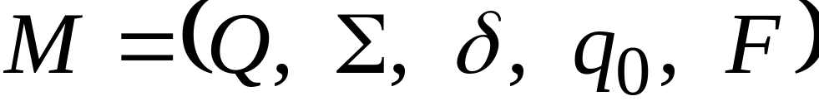
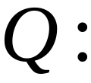



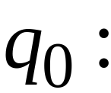

Nondeterministic Finite Accepter (NFA)
Set of states
Input alphabet
Transition function
Initial state
Final states

Slide 3
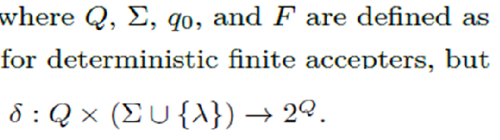
Nondeterministic Finite Accepter (NFA)
2^{Q} is referred to as the power set of Q and is defined as the set of all subsets of Q including the empty set and Q itself.
For example, if Q = {q₀,q₁}, the power set of Q is
{}, {q₀}, {q₁}, {q₀,q₁}

Slide 4
Nondeterministic Finite Accepter (NFA)
NFA permits several possible “next states” specified in one of the subsets of the power set.
i.e., for a given combination of current state and input symbol, the next state is not uniquely defined as in a DFA.
The automaton, as it reads the input string, may choose at each step to go into any one of these legal next states; the choice is not determined by anything in our model, and is therefore said to be nondeterministic.

Slide 5



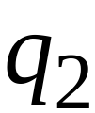



Example of NFA
Note: Two choices from q₀ on input “a”
(q₀,a) = {q₁,q₃}
Note: No transition defined on q₂ and q₃

Slide 6
First Choice

Slide 7
First Choice

Slide 8
First Choice

Slide 9
First Choice
All input is consumed
“accept”

Slide 10
Second Choice

Slide 11
Second Choice

Slide 12
Second Choice
Next input cannot be consumed
No transition:
the automaton hangs
“reject”

Slide 13
An NFA accepts a string
when there is a computation
(on any one of the choices)
of the NFA that accepts the string
AND
all the input is consumed and the automaton
is in a final state

Slide 14

Example
is accepted by the NFA because at least
one choice below leads to acceptance
“accept”
“reject”
because this
computation
accepts

Slide 15

Example (Rejection)
is rejected by the NFA
“reject”
“reject”
All possible computations lead to rejection

Slide 16
An NFA rejects a string:
when there is no computation of the NFA
that accepts the string:
All the input is consumed and the
automaton is in a non final state
OR
The input cannot be consumed

Slide 17
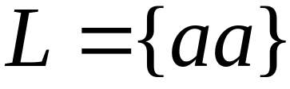
Language accepted:

Slide 18



Lambda Transitions in NFA
NFA allows transitions.
The transition takes place without consuming an empty string.
Note does not occur on the input

Slide 19
Example NFA with transitions
Input

Slide 21
read head does not move
Transition happens

Slide 23
all input is consumed
“accept”
String is accepted

Slide 24
Rejection Example

Slide 26
(read head doesn’t move)

Slide 27

No transition possible from q₃
Input cannot be consumed and the automaton hangs;
String is rejected

Slide 28
Language accepted:

Slide 29
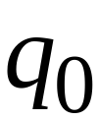


Another NFA Example

Slide 30

Input string

Slide 33
“accept”

Slide 34
Another input string

Slide 37
(read head doesn’t move)

Slide 38
(read head doesn’t move again)

Slide 41
“accept”

Slide 42
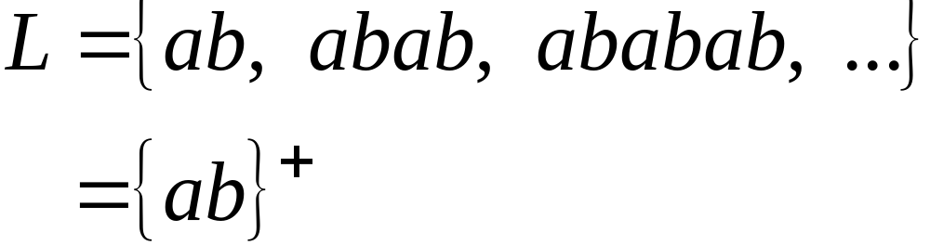
Language accepted

Slide 43

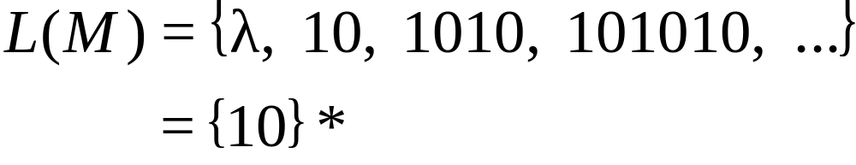

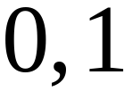

Another NFA Example
(trap/dead state)

Slide 44
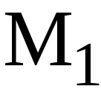
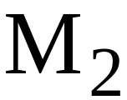
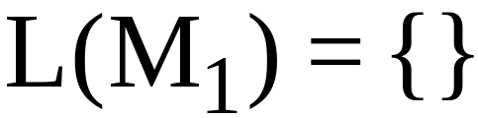
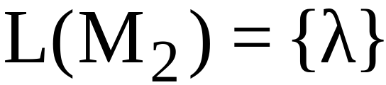
Remarks:
The symbol never appears on the
input tape
Simple automata:

Slide 45
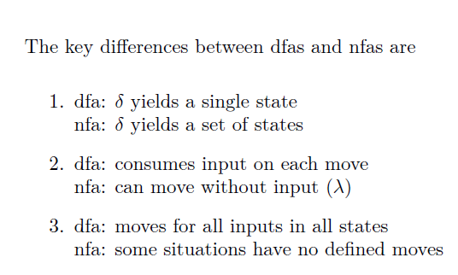
Remarks:

Slide 46




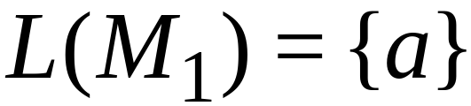
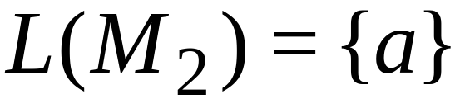
NFAs are interesting because we can
express languages easier than DFAs
NFA
DFA

Slide 47

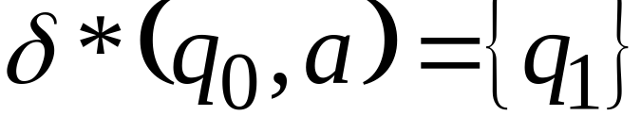





Extended Transition Function
As with dfas, the transition function can be extended so its second argument is a string.

Slide 48
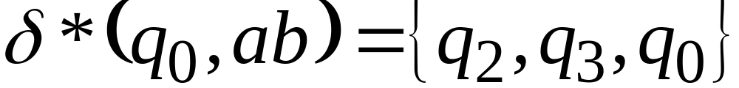

Slide 49
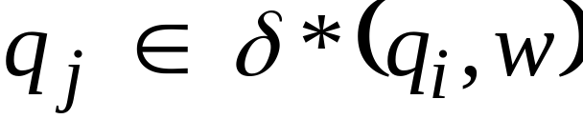

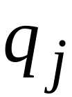




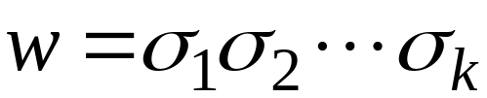



Formally
One possible walk from to
with label

Slide 50

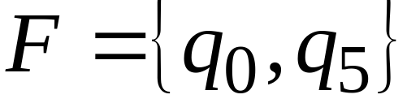
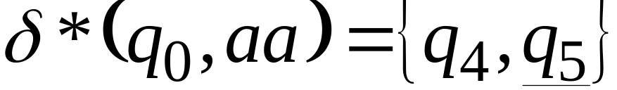
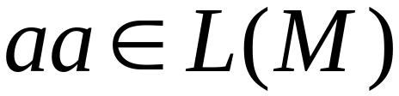

The Language of an NFA

Slide 51
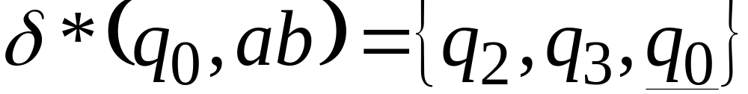
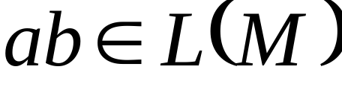

Slide 52
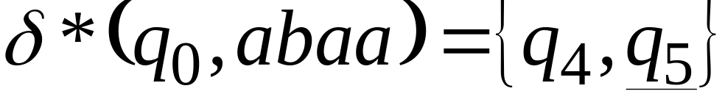

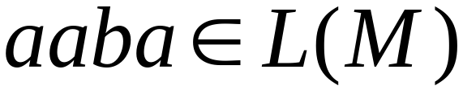

Slide 53
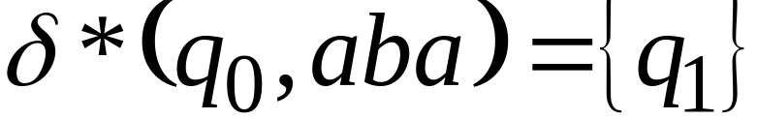
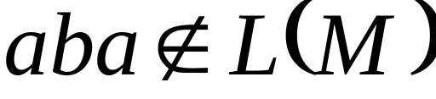


Slide 54
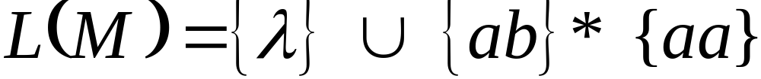

Slide 55
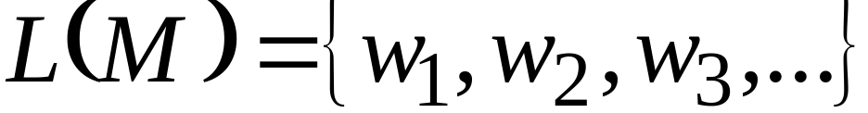
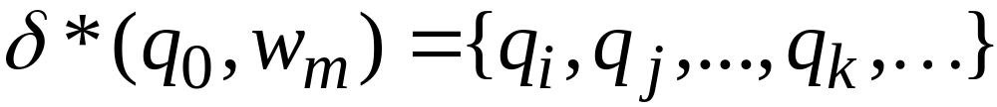
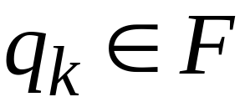
Formally
The language accepted by NFA is:
where
and there is some
(final state)

Slide 56
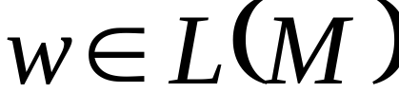
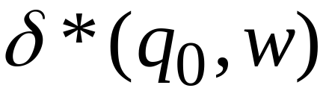




i.e., L(M) is the set of all strings w for which there is a walk labeled w from the initial vertex of the transition graph to some final vertex.

Slide 57
1) an nfa can model a search or backtracking algorithm
2) nfa solutions may be simpler than dfa solutions (can convert from nfa to dfa)
3) Note that complementing a NFA is a non-trivial task (unlike DFAs where all you needed to do was to just flip the accepting/non-accepting states).
Nondeterminism

Slide 58
I) Do exercises : #5 to #14
II) Construct an NFA over the input alphabet
Σ = {a,b,c} that accepts all strings a^{i}b^{j}c^{k} where i,j,k are all greater than or equal to 0.
Homework 2.2

